Slide 1
Databases Assignment Presentation
Student Name: Michail Sideris
Student ID: 2526787
Module: THE5001 Databases
Tutor: Konstantinos Tsakonas

Slide 2
The assignment was about creating a database for a bank.
The database stores:
• Customers
• Accounts
• Credit cards
• Transactions
• Stores
• Payments
• Areas
The goal was to design the database and then implement it using SQL in MySQL.

Slide 3
Main requirements:
• Store customer information
• Allow multiple accounts per customer
• Connect credit cards with accounts
• Store transactions
• Store shop information
• Track payments
• Connect customers and stores with areas

Slide 4
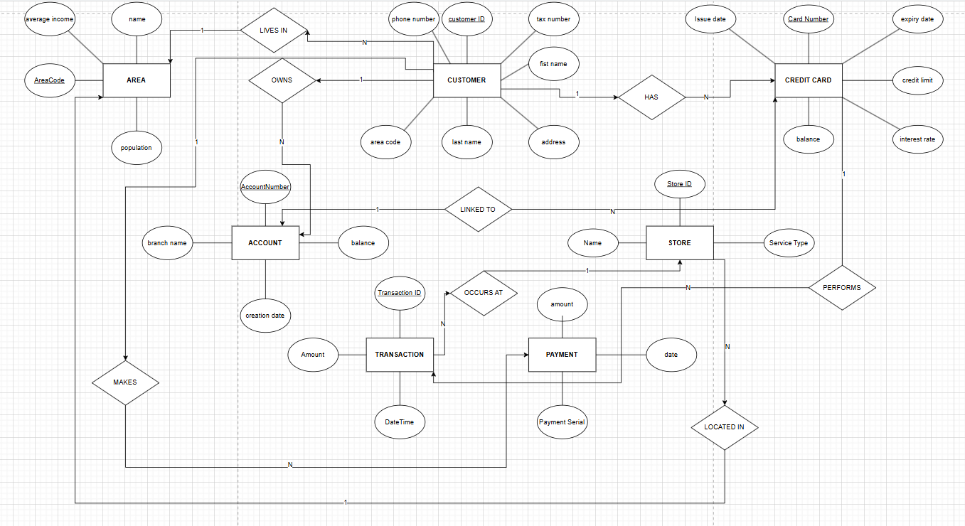
The ERD was designed based on the requirements of the system and the relationship between entities
The main entities are:
• Customer
• Account
• CreditCard
• Transactions
• Store
• Payment
• Area
Relationships between entities were identified and represented using primary and foreign keys.

Slide 5
ERD → SCHEMA :
~Customer:
CustomerID PK, FirstName, LastName, Address, TaxNumber, PhoneNumber ,AreaCode FK
~Area:
AreaCode PK, Name, Population, AverageIncome
~Account:
AccountNumber PK, Balance, CreationDate, BranchName, CustomerID FK
~CreditCard:
CardNumber PK,IssueDate, ExpiryDate, CreditLimit, InterestRate, Balance, CustomerID FK AccountNumber FK
~Store:
StoreID PK, Name, ServiceType, AreaCode FK
~Transaction:
TransactionID PK, Amount, DateTime, CardNumber FK, StoreID FK
~Payment: CustomerID FK, PaymentSerial, Date, Amount, CustomerID PK, PaymentSerial PK
The ERD entities were converted into relational tables. Primary keys uniquely identify records, while foreign keys connect related tables

Slide 6
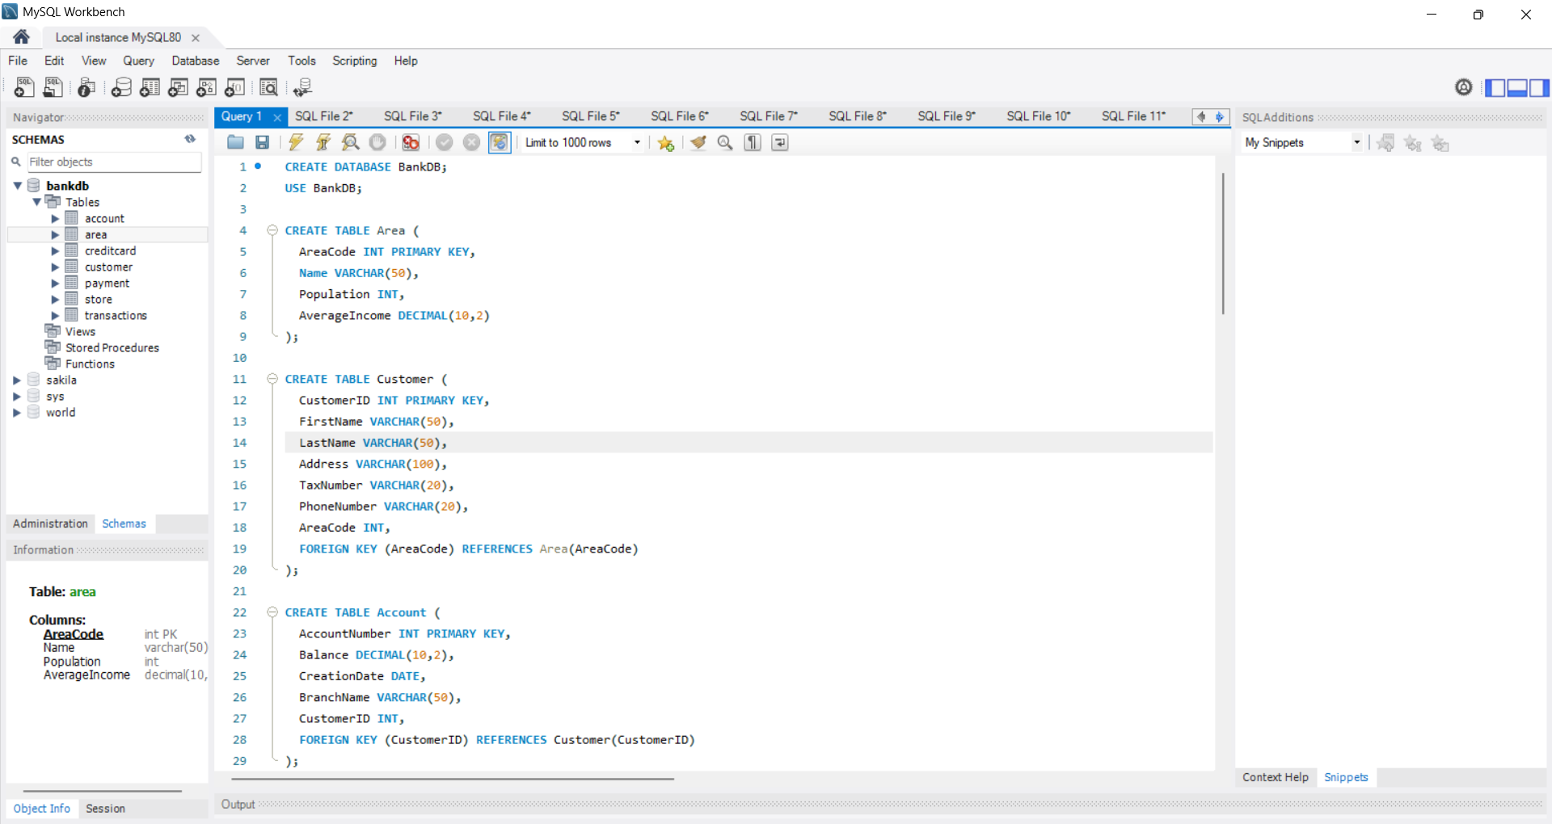
SQL Database Creation
I implemented the database in MySQL using SQL commands such as:
• CREATE DATABASE
• CREATE TABLE
• PRIMARY KEY
• FOREIGN KEY

Slide 7
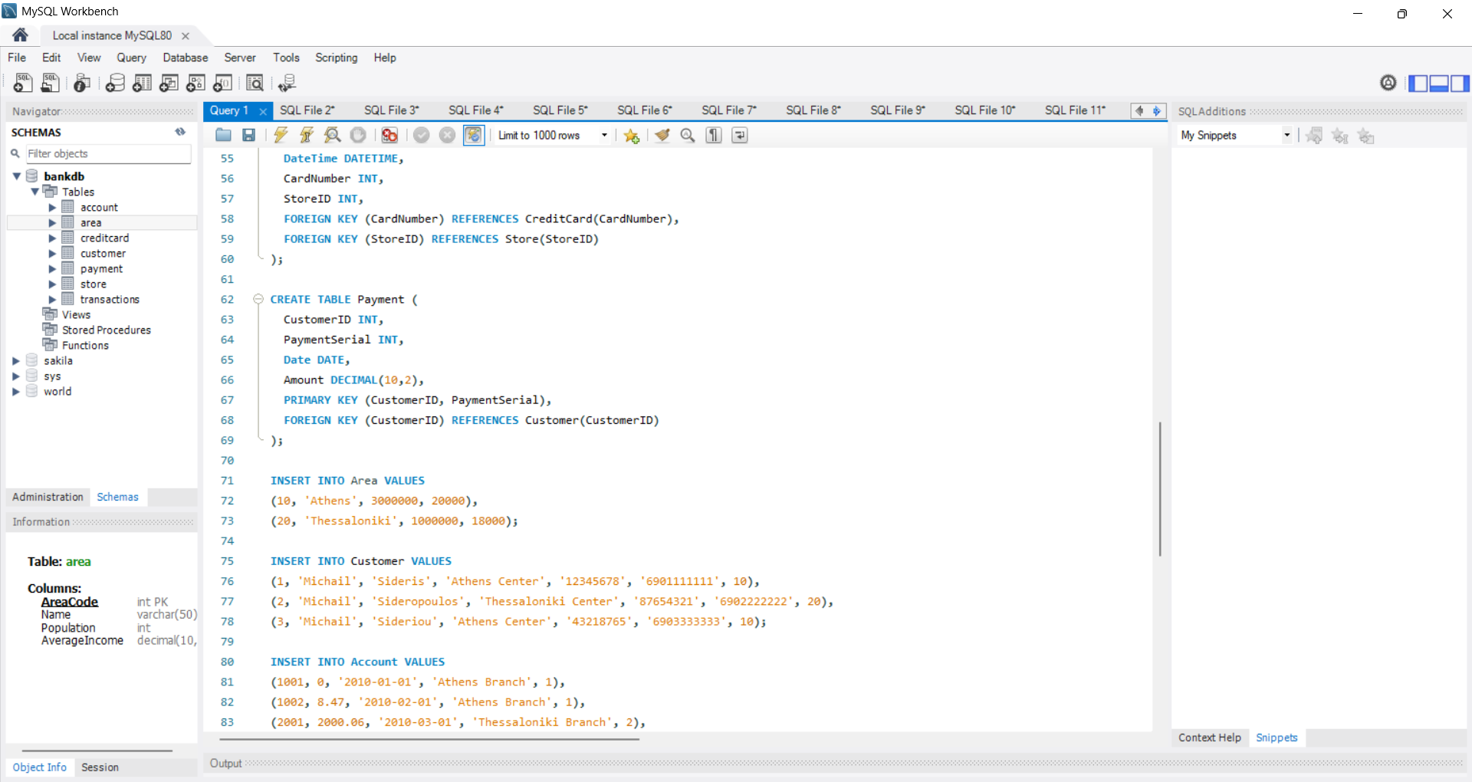
Data Insertion
I inserted sample values into the database tables. The values were used to: • Test the database • Test the queries • Check if relationships work correctly

Slide 8
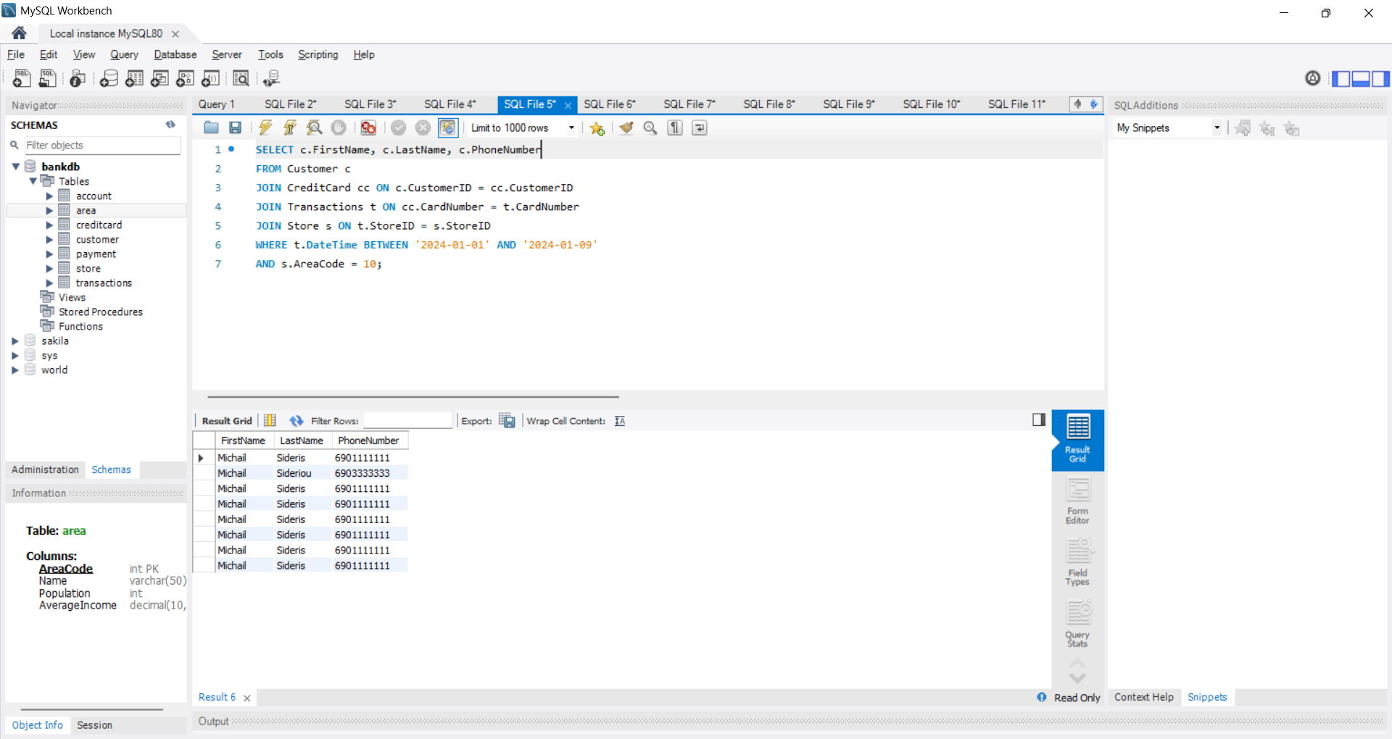
Complex Query Example
Query 4
Show the name and phone number of customers who made a transaction from 1/1/2024 to 9/1/2024 at a store in the area code 10.
SELECT c.FirstName, c.LastName, c.PhoneNumber
FROM Customer c
JOIN CreditCard cc ON c.CustomerID = cc.CustomerID
JOIN Transactions t ON cc.CardNumber = t.CardNumber
JOIN Store s ON t.StoreID = s.StoreID
WHERE t.DateTime BETWEEN '2024-01-01' AND '2024-01-09'
AND s.AreaCode = 10;

Slide 9
Explanation of query 4
This query uses multiple JOIN operations to connect:
• Customer
• CreditCard
• Transactions
• Store
The WHERE clause filters:
• Transactions between two dates
• Stores located in AreaCode 10

Slide 10
Conclusion
The database was successfully created and implemented.
The final system supports:
• Customers
• Accounts
• Transactions
• Payments
• Credit cards
This assignment helped me improve my SQL and database design skills.

